Slide 1
FACE RECOGNITION USING IMAGE PROCESSING.
BATCH- IT-1
K.V.Hemanth -207Z1A1225
Sheldon Shaji -207Z1A1241
V.Nikil -207Z1A1248
Under Guidance :
Mr. T. Madhu

Slide 2

PROJECT MODULES
Image capture
Image processing
Face recognition

Slide 3
IMAGE CAPTURE
Digital Camera.
Resolution must be fixed
Position of the face need not to be fixed
Can wear spectacles.

Slide 4
IMAGE PROCESSING
Understanding how does the system looks at the image
Converting colour image to grayscale image
Converting grayscale image to black and white image

Slide 5
FACE RECOGNITION
Neural networks are designed to work just like the human brain.
An Artificial Neural Networks is made up of 3 components:
Input Layer
Hidden (computation) Layers
Output Layer.

Slide 6
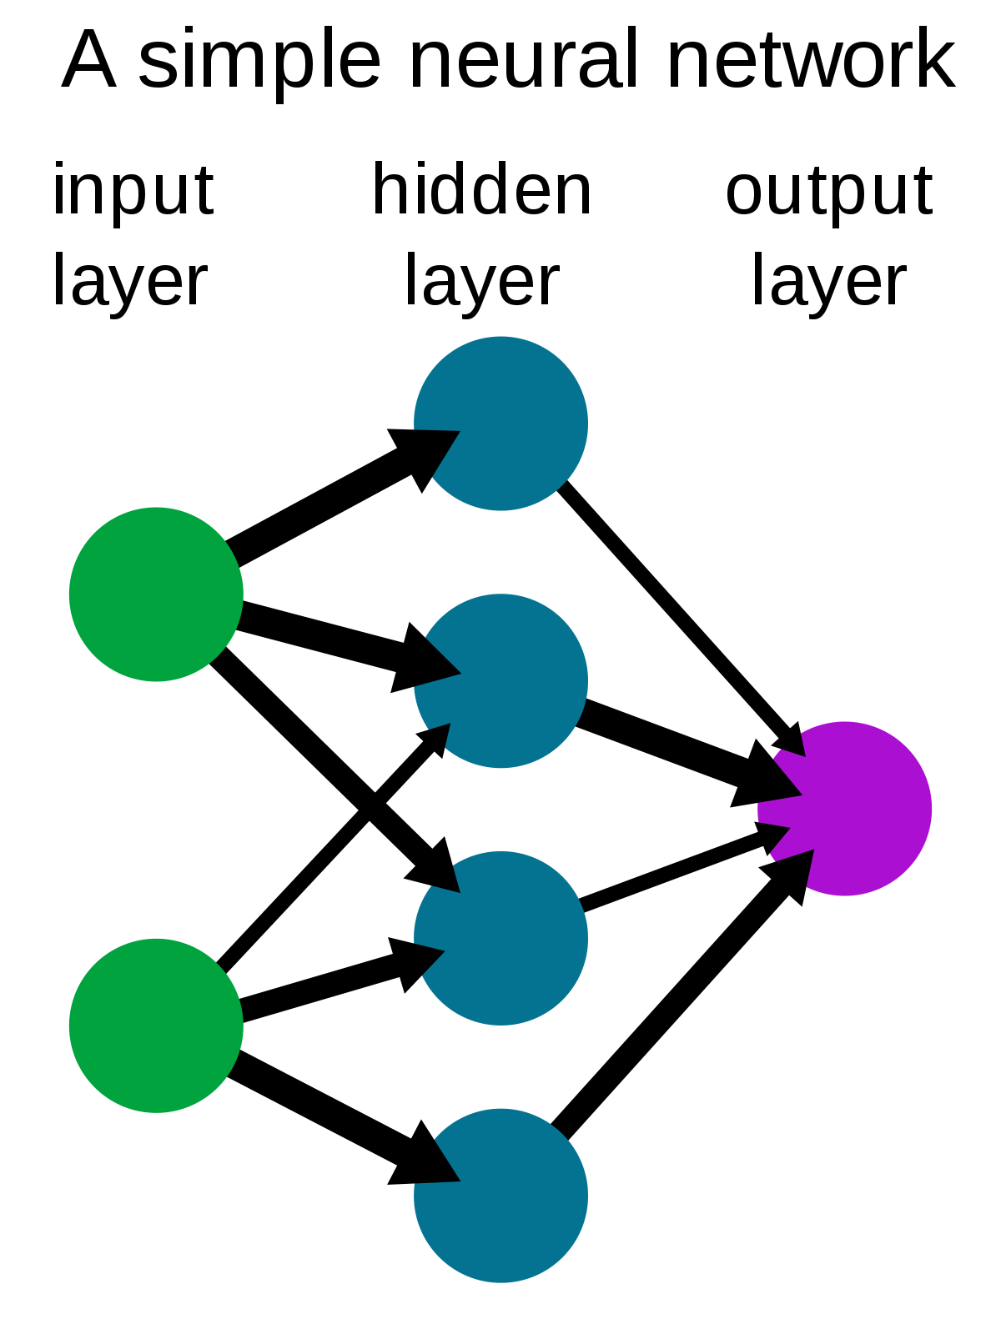

Slide 7
HAAR CASCADE
Haar Cascade is a machine learning-based approach where a lot of positive and negative images are used to train the classifier.
POSITIVE IMAGES – These images contain the images which we want our classifier to identify.
NEGATIVE IMAGES – Images of everything else, which do not contain the object we want to detect.

Slide 8
THANK YOU

